Slide 1
Fellow and mentor nomination process
Guidelines and requirements for fellow and mentor nomination
October 2024

Slide 2
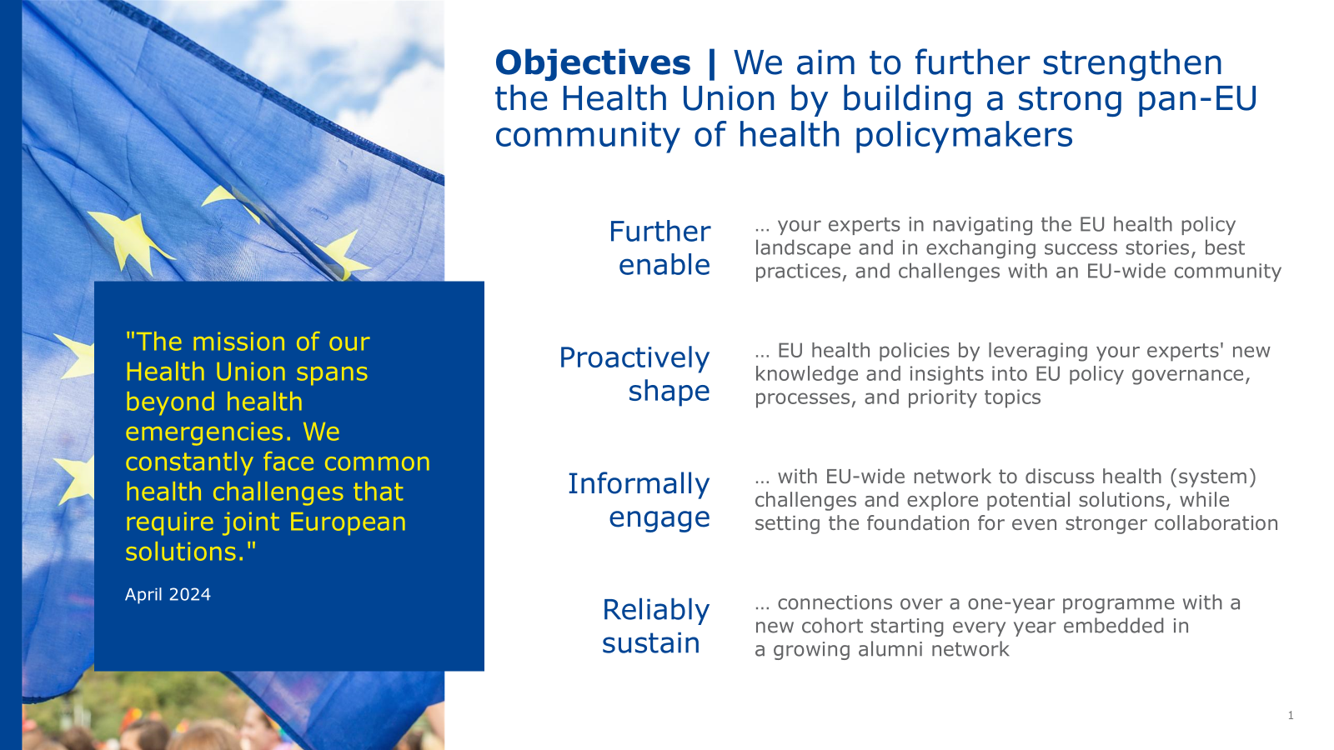

Snapshot academy | The academy aims to strengthen the Health Union by building a pan-EU community of health policymakers
      Objectives
      Stakeholders
      Structure
Further enable experts to navigate EU health policy landscape
27 fellows from all Member States in 1st cohort
Face-to-face and virtual training workshops
Joint EU health policy projects as group work
27 mentors, ideally from all Member States
Proactively shape EU health policies by utilising experts' new learning
Community building via learning & online platform
Advisory Board of EU health stakeholders
Informally engage with EU-wide network on health (system) challenges
Ongoing mentoring through dedicated support
Broader EU health policy community
Annual forum as closing event for reflection
Reliably sustain connections beyond one-year academy
Academy enabling structure
Individual and joint reflection
      Please view Information Package for detailed information

Slide 3
Please nominate up to three fellows and one mentor by November 18 (EOB)
How to submit the nomination
  Process can be led by Ministry of Health's Single Point of Contact (SPOC)¹
1
      Fellow nomination
Please provide us with the following by November 18 (EOB):
  A ranked list of up to three fellows in line with the selection criteria (see the following pages)
  One completed CV for each nominated fellow
  Please share your nomination via e-mail Sante-Health-Academy@ec.europa.eu
Please list your ranked fellows and the mentor in the e-mail and attach their CVs (both for fellows & mentor)
2
      Mentor nomination
Please provide us with the following by November 18 (EOB):
  Nomination of one mentor in line with the target profile provided (see on following pages)
  Completed CV for the nominated mentor
For the CV, if possible use the suggested template provided and ensure full completion to support a successful academy
EOB = end of business
1. See academy letter and information package for more information reg. SPOC nomination

Slide 4
Fellow profile
      Overview of the selection criteria
      Must-have criteria
Employed with the Ministry of Health or other administration (national, regional, local) involved in EU health policy for a minimum of one year
Previous work experience in the health sector (e.g., public, private, or academia)
Commitment to active participation (~25-30 days), including:
  Attendance of three face-to-face trainings¹ and one annual forum
  Attendance of three virtual two-day training sessions
  Ongoing engagement and active contribution as part of 1st cohort
  High motivation for future engagements, e.g., as alumni and possibly mentors
Proficient English language skills (at least C1 level)
Mid-career professionals from the Ministry of Health or other administration involved in EU health policy, already or expected to be (soon) involved in EU health policymaking
      Nice-to-have criteria
(Initial) experience in EU (health) policymaking
Focus on one of the EU health priorities such as health prevention and control (communicable & non-communicable diseases), crisis preparedness, global health, One Health, pharmaceutical and medical devices legislation, digital health, workforce crisis
Leadership experience (e.g., project, unit, working group) and a cross-cutting role
Degree in relevant field, e.g., health-related (medicine/pharmacy/biology/ veterinary/nursing), public health, social or political science, or law
1. One five-day face-to-face workshop with six nights stay, two three-day face-to-face workshops with four nights stay

Slide 5
Mentor profile
      Overview of the selection criteria
      Must-have criteria
Significant multi-year leadership experience at the Ministry of Health and/or at other national health bodies involved in EU health policymaking
Experience in EU health policymaking (e.g., development, implementation, advocacy)
Commitment to active contribution (at least five days), including:
  1:1 support to fellows in regular touchpoints
  Support of joint EU health policy projects (e.g., expert input)
  Participation in select required meetings, such as quarterly mentor forums
  Select contribution to training sessions (depending on e.g., policy focus)
Proficient English language skills (at least C1 level)
Senior leads (e.g., head of directorate-general) at Ministries of Health at the national level or other national health bodies,
(prior) involvement in EU health policymaking
Deep-dive on mentor role on following page
      Nice-to-have criteria
Experience as a trainer and/or mentor
Ideally, current focus of own work on one of the EU health priorities such as health prevention and control (communicable & non-communicable diseases), crisis preparedness, global health, One Health, pharmaceutical and medical devices legislation, digital health, and workforce crisis

Slide 6
Mentor role | Each mentor will support a fellow along three main dimensions
      Fellow support
      Training contribution
      Mentor exchange
      Optional:
      Advisory Board
Conduct regular, informal 1:1 touchpoints with assigned fellow to share knowledge, provide advice, and support the overall academy
Support joint EU health policy project for one research group¹
Facilitate contact with other experts and relevant networks
Monitor fellow progress and provide feedback via informal touchpoints and mid-term check-in
Participate in at least 1 virtual training session
Contribute to training facilitation (e.g., share success stories, moderate a break-out group)
Participate in the one-day Annual Forum
Optional: Participate in one or more face-to-face training sessions
Attend the virtual mentor kick-off meeting to learn more about the programme details
Participate in three virtual mentor forums (quarterly rhythm) to share feedback and receive additional support in the mentor role
Become member of Advisory Board and provide strategic guidance on academy
Contribute to monitoring fellowship outcomes and defining adjustments
Supported by: Training coordinator and enabling structure
1. Four collaborative groups with six to seven fellows; shared task with mentors in respective group

Slide 7
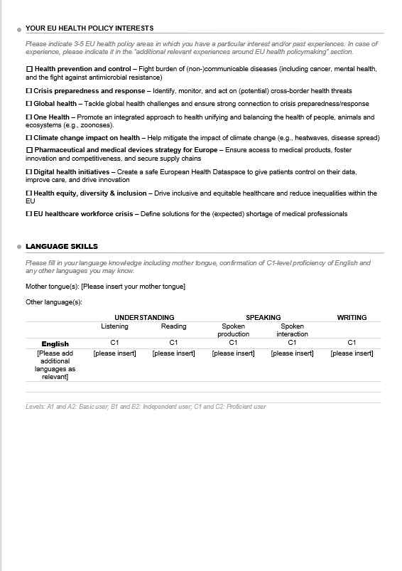
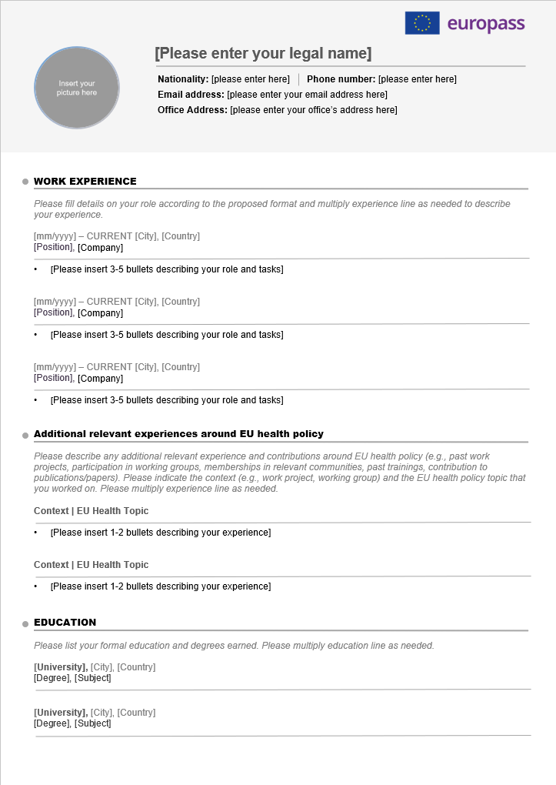
CV template | lf possible, please use the attached template for the fellows and the mentor and submit completed CVs with your nomination
      Please share CV suggested template with nominated fellows and mentors
      Template includes guidelines for completing the CV and indicates where to insert data by [please insert …]
1
      Please ensure that CVs are duly and fully completed by fellows and mentors in line with the guidelines provided
2
  Please submit the CVs with your ranked fellow list and your mentor nomination via e-mail (Sante-Health-Academy@ec.europa.eu)
3
Template shared as separate attachment

Slide 8


In case of questions:
      Please do not hesitate to contact:
      Sante-Health-Academy@ec.europa.eu

